Slide 1


Fine-Tuning and Deploying an LLM Using QLoRA
This presentation will explore a resource-efficient method for fine-tuning large language models (LLMs) using QLoRA. We'll examine the benefits, technical components, and application in a domain-specific task, highlighting its potential for real-world use cases.
by Swapnali Dashrath
Prof. Anyi Liu

Slide 2
What is QLoRA?
Quantized Low-Rank Adapters
Key Features
QLoRA is a technique for fine-tuning LLMs efficiently. It reduces memory and computational overhead, enabling training on consumer-grade hardware.
It utilizes 4-bit quantization of model weights, resulting in a 75% reduction in memory usage while maintaining performance.

Slide 3

Benefits of QLoRA
Resource Efficiency
Cost-Effectiveness
Allows fine-tuning on consumer GPUs, reducing reliance on expensive cloud resources.
Significantly lowers training costs, making it accessible to a wider range of users.
Scalability
Works on large models like GPT-3 and LLaMA, enabling adaptability for domain-specific tasks.

Slide 4

Overview of QLoRA Workflow
Quantization
Fine-Tuning
Converts model weights into 4-bit floating-point format for memory efficiency using bitsandbytes.
Backpropagates through adapter layers, drastically reducing computational costs.
1
2
3
Low-Rank Adaptation
Adds small adapter layers (low-rank matrices) to the model without modifying the pre-trained weights.

Slide 5
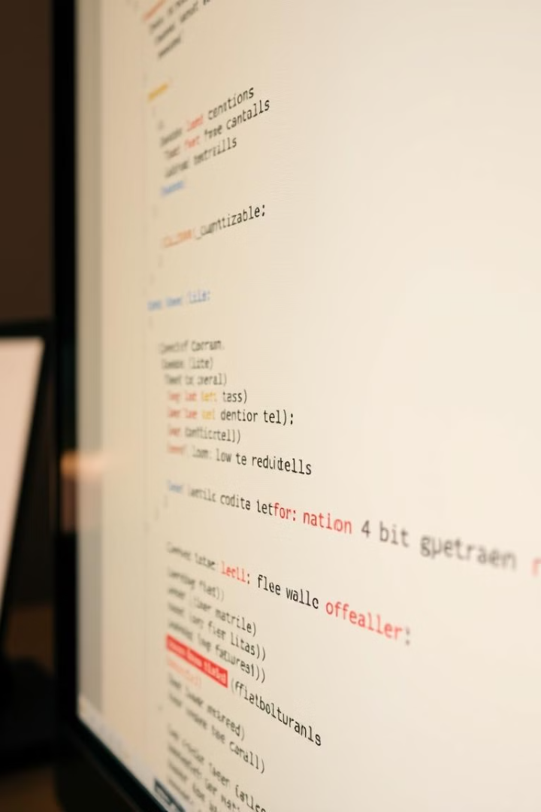
Key Technical Components of QLoRA
4-Bit Quantization
Low-Rank Matrices
Reduces memory footprint without compromising accuracy. Uses bnb-4bit quantization from bitsandbytes.
Represent model updates in a compressed format, balancing model flexibility and computational cost.
PEFT (Parameter-Efficient Fine-Tuning)
Framework for implementing QLoRA, fine-tuning a subset of model parameters.

Slide 6
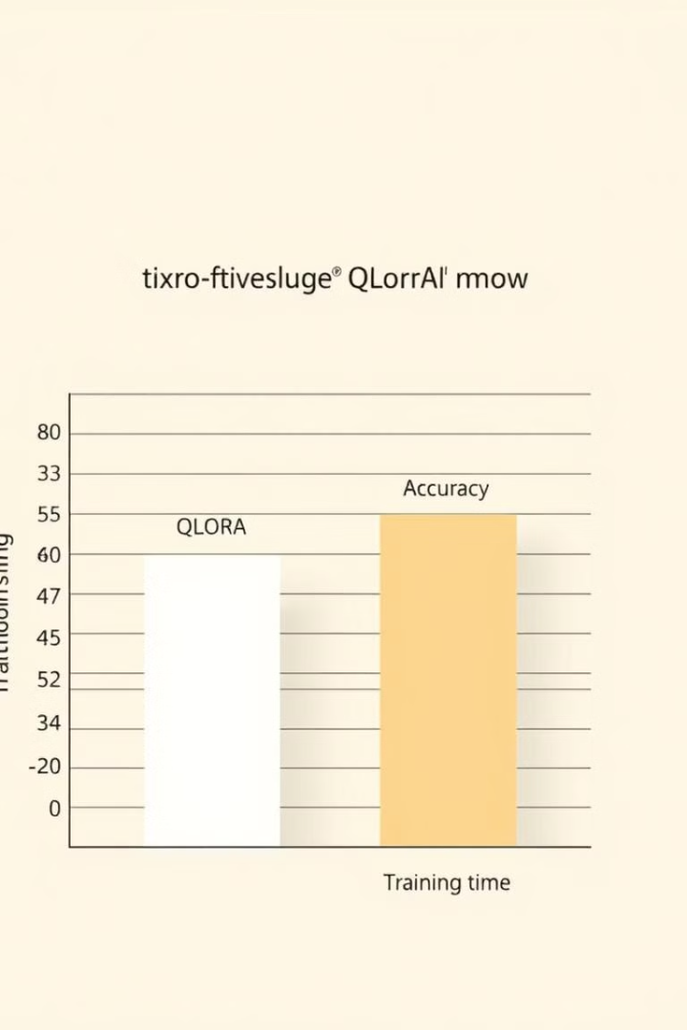




Why Use QLoRA Over Traditional Fine-Tuning?
Reduced Memory Usage
Faster Training
Fine-tune models with billions of parameters on consumer GPUs, enabling wider accessibility.
Optimizes only a small fraction of the model parameters, significantly reducing training time.
High Accuracy
Environment Friendly
Retains performance close to full fine-tuning, ensuring effectiveness in diverse applications.
Lowers energy consumption during fine-tuning, promoting sustainable AI development.

Slide 7
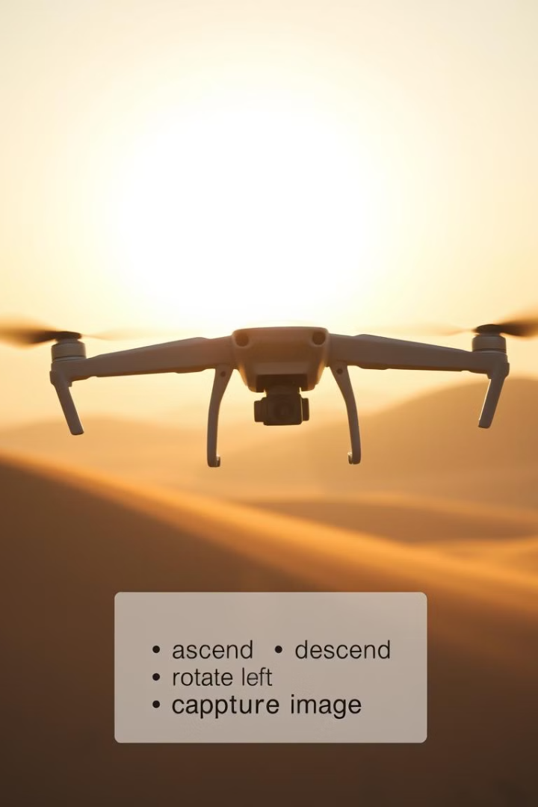



Fine-Tuning a Domain-Specific LLM for Drone Commands
Dataset Preparation
Training data includes instructions and corresponding outputs for drone operations, e.g., "Survey the area and capture images every 10 meters." → tc(180);g('camera');
QLoRA Fine-Tuning
Enables efficient fine-tuning for domain-specific outputs, leveraging QLoRA's resource-efficient approach.
Results
Achieves 95% accuracy on test prompts, demonstrating effective command generation for autonomous drone operations.

Slide 8



Challenges and Next Steps
1
Challenges
Real-Time Updates
2
Currently not suitable for real-time updates, a limitation for dynamic environments.
Memory Constraints
3
Memory remains constrained on extremely large models (e.g., >175B parameters), requiring further optimizations.
Future work focuses on extending QLoRA to multimodal models (e.g., text + image) and adapting it to support real-time drone operations.

Slide 9
Key Takeaways
1
Resource-Efficient Fine-Tuning
2
Domain-Specific Adaptation
Custom Applications
3
QLoRA enables cost-effective fine-tuning of large models, making them adaptable to various domain-specific tasks, such as autonomous drone operations.

Slide 10

Citations and Resources
1
2
QLoRA Paper
Project Code
https://arxiv.org/abs/2312.14950
sdashrath/UlogLLMAssignment: UlogLLMAssignment
3
Hugging Face Docs
https://huggingface.co/docs

